Slide 1

SEM
Wouter Duverger
15 February 2023

Slide 2
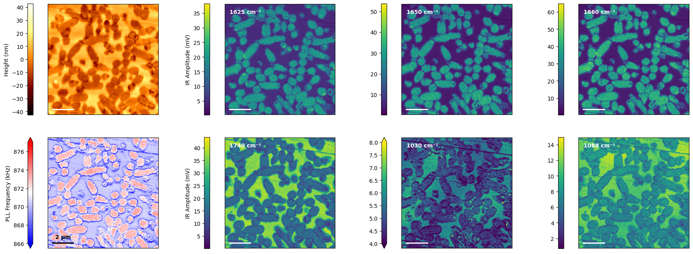
Region 1: with AFM

Slide 3
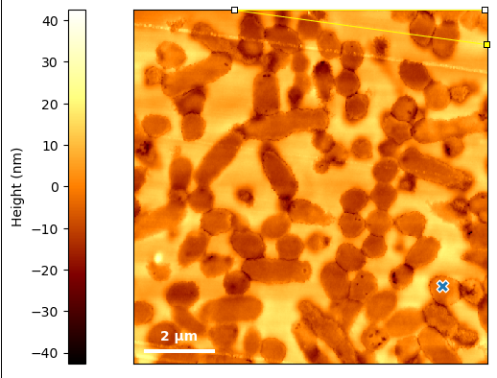
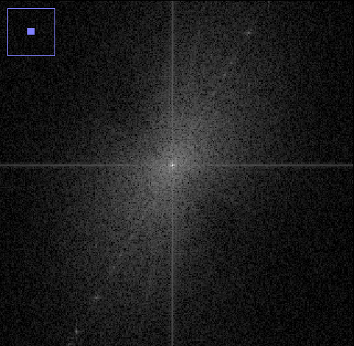
Line streaks in region 1
Knife cut to horizontal: 10º
Knife cut to horizontal: 10º
Streaks to x: 30º

Slide 4
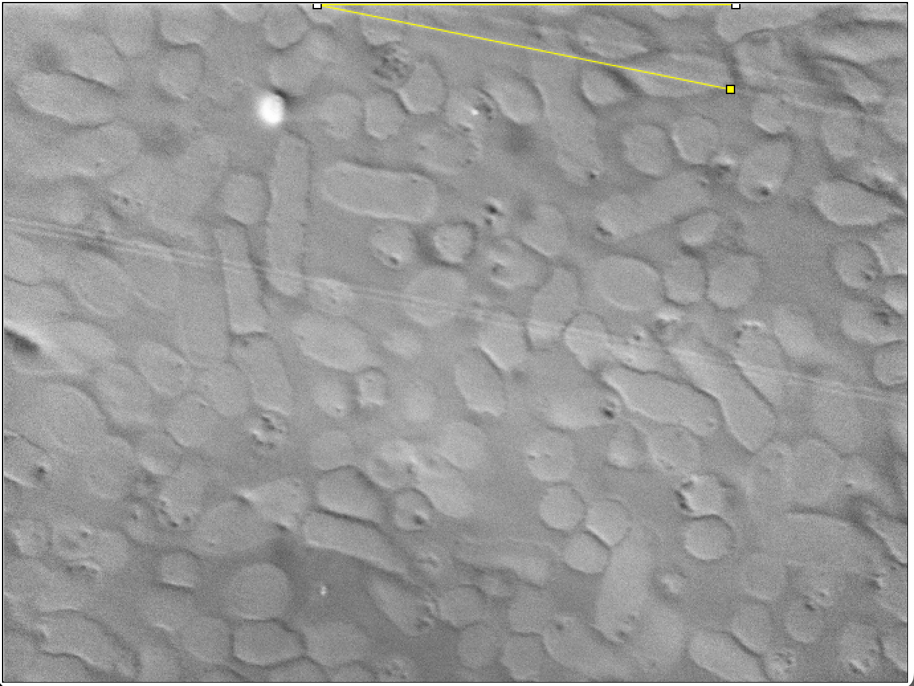
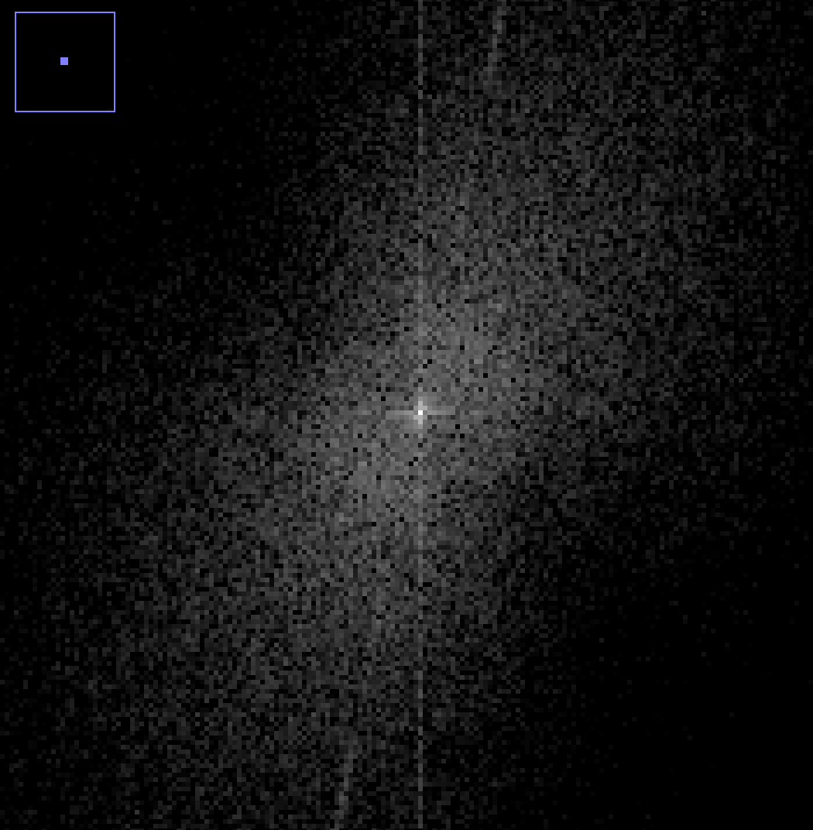
Region 2: no AFM, no second set of lines

